Slide 1
Сотрудничество и креативность как основа современных технологий и условия формирования и развития иноязычной компетенции учащихся.
Тиунова Елена Вадимовна
Учитель английского языка МБОУ ВОК СП школа 121

Slide 2
Are you telling the truth ?

Slide 4
4 corners
Agree
Disagree
Agree more
Disagree more

Slide 5
Bananas are

Slide 7
An air-balloon trip

Slide 8
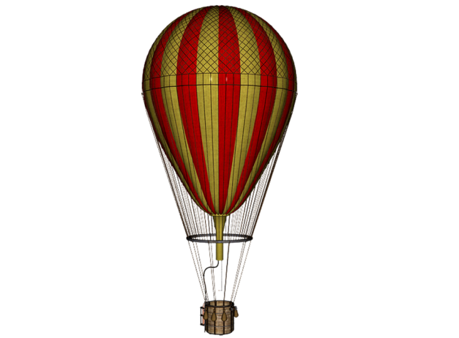
www.vk.com/egppt
GO
At a remote island, a volcano suddenly started to erupt. There was
no time to escape and there were no means of transportation off the small island except for one hot air balloon.
All of the people managed to climb aboard the hot air balloon but
it’s dangerously heavy. If one person is thrown overboard, the balloon will make it to the safety of a distant island. If not, everyone will die.
The question is, who should be pushed out of the hot air balloon?

Slide 9
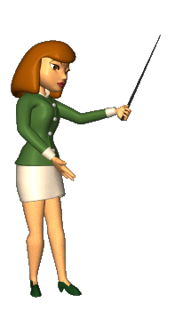
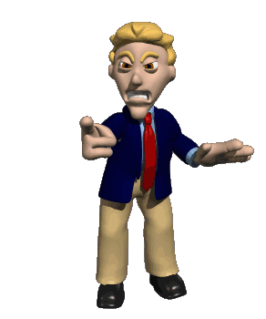
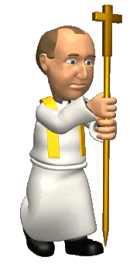
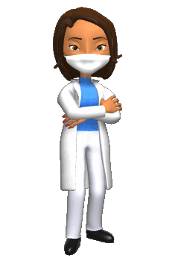
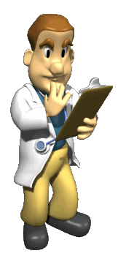
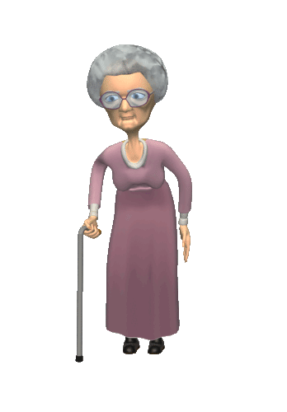
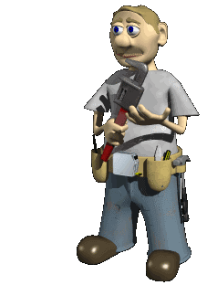
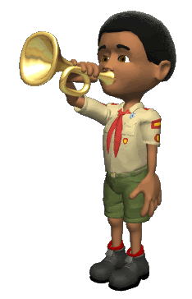
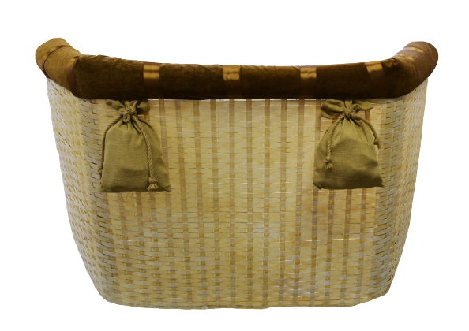
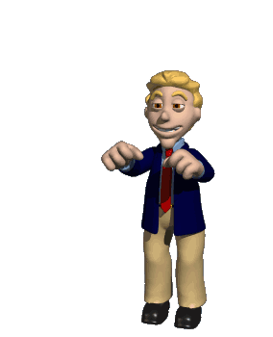
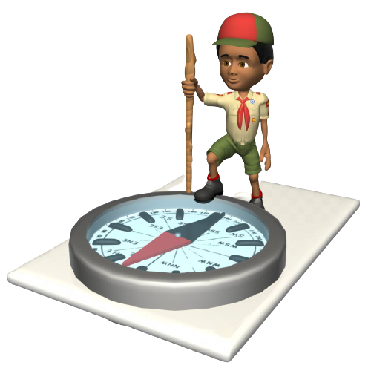
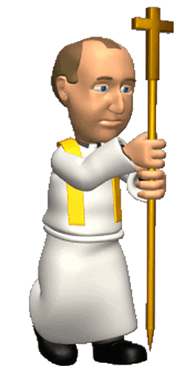
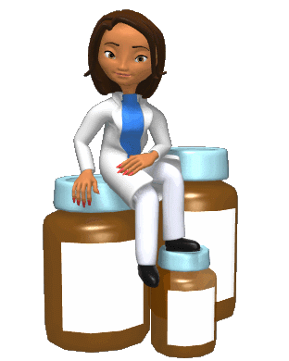
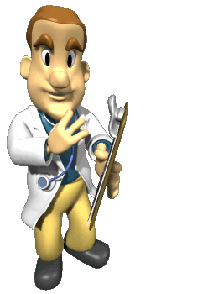
Who will be
thrown overboard?
The Boy scout
The Doctor
The Priest
The Nurse
The Volunteer
The Builder
The Teacher
The Politician
The Builder
The Boy scout
The Politician
The Nurse
The Volunteer
The Teacher
The Priest
The Doctor
Click a person to get some information.
Strong & can build
almost anything.
Natural leader,
good communicator.
Very popular & outgoing,
optimistic.
Very friendly & generous.
Likes to gossip.
Hardworking, gentle,
always ready to help.
Intelligent, quiet,
a very good doctor.
Clever, fun to be with,
always helping others.
Age: 45
Married
3 kids
(1 is adopted)
Honest, basic survival skills,
a good student.
Age: 25
Engaged
2 sisters
1 brother
Age: 16
Single
1 sister
Age: 39
Married
2 sons
Age: 56
Married
3 kids
Age: 33
Single
2 brothers
Age: 42
Married
2 kids
Age: 28
Married
No kids
Make sentences:
CLICK
CLICK
CLICK
CLICK
CLICK
CLICK
CLICK
CLICK
Likes fixing things &
being with his family.
Likes talking, shopping
& gardening.
Likes building things &
using a computer.
Likes baking &
visiting elderly people.
Likes travelling, cooking
& gardening.
Likes working &
playing chess.
Likes fishing, sports
& camping.
Likes swimming &
playing the piano.
……… SHOULD ……… because ………
www.vk.com/egppt

Slide 10
The Boy scout
has been put on probation
for public indecency.
BACK
www.vk.com/egppt

Slide 11
The Teacher
divorced her first husband
so that she could marry
her boyfriend.
BACK
www.vk.com/egppt

Slide 12
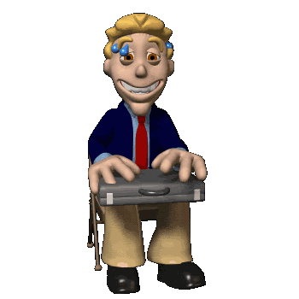
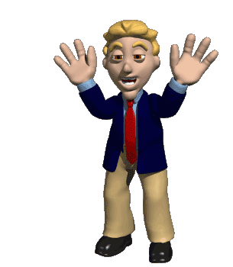
The Politician
may have taken bribes
from his brother’s
construction company.
BACK
www.vk.com/egppt

Slide 13
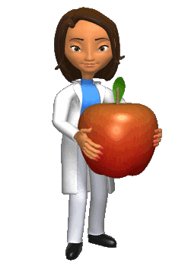
The Nurse
was arrested twice
for drunk driving
in the last three years.
BACK
www.vk.com/egppt

Slide 14
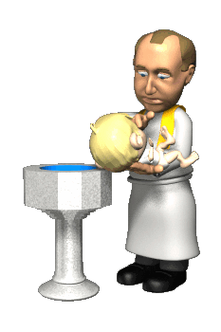
The Priest
fathered a daughter
several years ago
but keeps this a secret.
BACK
www.vk.com/egppt

Slide 15
The Doctor
has been accused of
at least a dozen
malpractice cases.
BACK
www.vk.com/egppt

Slide 16
The Volunteer
is suspected for
taking donation money
from the elderly.
BACK
www.vk.com/egppt

Slide 17
The Builder
collects hand guns and
believes everyone has
the right to own them.
BACK
www.vk.com/egppt

